Slide 1

Forecast Hourly Energy Consumption
Team 6
Mentor Name: Neha Gupta
16/09/2022

Slide 2
Business Problem
Given the historical power consumption, what is the expected power consumption for the next 30 days?.
DATASET: The hourly power consumption data comes from PJM's website and are in megawatts (MW).
PJM Interconnection LLC (PJM) is a regional transmission organization (RTO) in the United States. It is part of the Eastern Interconnection grid operating an electric transmission system serving all or parts of Delaware, Illinois, Indiana, Kentucky, Maryland, Michigan, New Jersey, North Carolina, Ohio, Pennsylvania, Tennessee, Virginia, West Virginia, and the District of Columbia.
Objective:
Split the last year into test set build a model to predict energy consumption.
Find the trends in energy consumption-Hourly, Daily, Weekly, Monthly and Yearly.
Understand how the trend changes depending on the time of the year – Seasonal and Holiday trends.
Forecast for next 30 days.

Slide 3
Project Architecture / Project Flow
Hourly
History
Sarima
Seasonal
Differencing
Random Forest
Daily
Forecast
Cleaning
Selection of model
Linear Regression
EDA
Aggregation to Daily
XG Boost

Slide 4
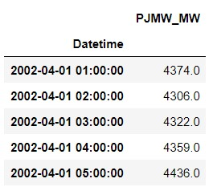
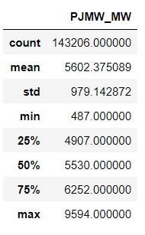
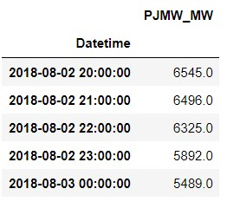
Overview of Dataset
It’s a hourly power consumption data from 2002 April1 to 2018 August 3.
The dataset name is PJMW_hourly.csv.
Rows: 143206 , column: 1 which is the power consumption value with datetime as index
Maximum power consumption is 9594 and it was in 2015
Minimum power consumption is 487 and it was in 2003
Missing hours : 30
Duplicate hours : 4
Outlier : 1
Head (5) :
Data description
Tail (5) :

Slide 5
Exploratory Data Analysis (EDA)
and
Feature Engineering

Slide 6
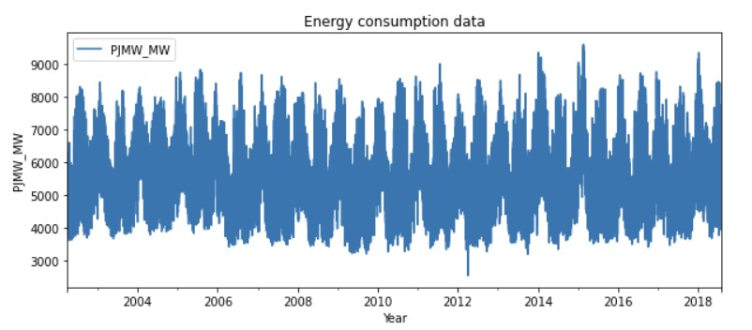
EDA
Sorted the data to arrange it in ascending order.
Removed the duplicate hours.
Imputed the missing hours with the average of above and below power consumption data using interpolation method.
Replaced the outlier using the interpolation linear method.
Extracted the hour, day, month, year and week name into separate column for checking the seasonality.
The cleaned data set is plotted as:

Slide 7
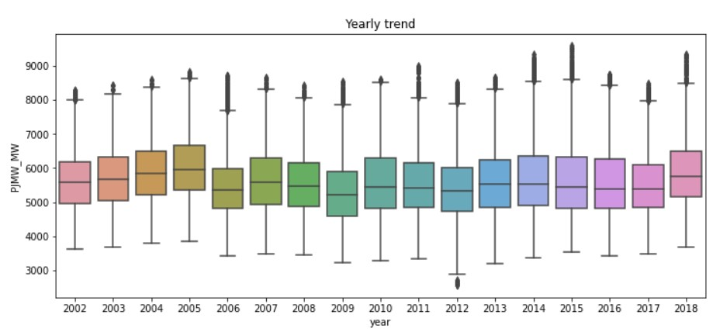
Yearly trend
Yearly trend analysis:
The plotted graph shows that 2005 have the highest and 2009 have the lowest power consumption.

Slide 8
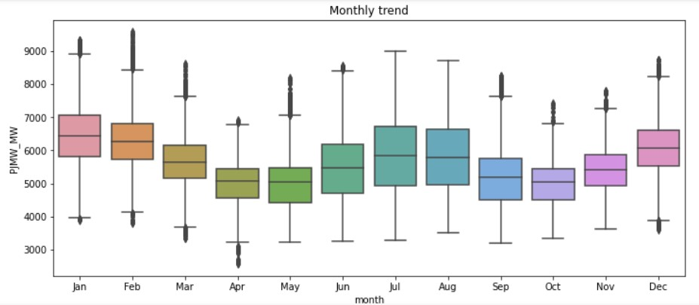
Monthly trend
Monthly trend analysis:
Decrease in power consumption is visible in the month of March, April, May and September, October, November.

Slide 9
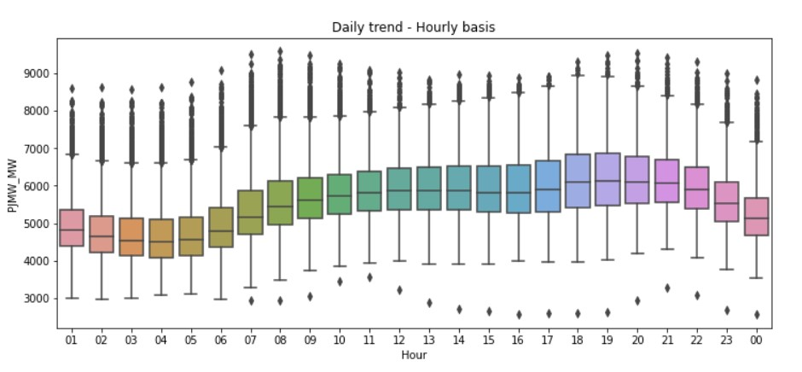
Hourly trend
Hourly trend Analysis:
Day time the power consumption seems to be increasing as compared to night.

Slide 10
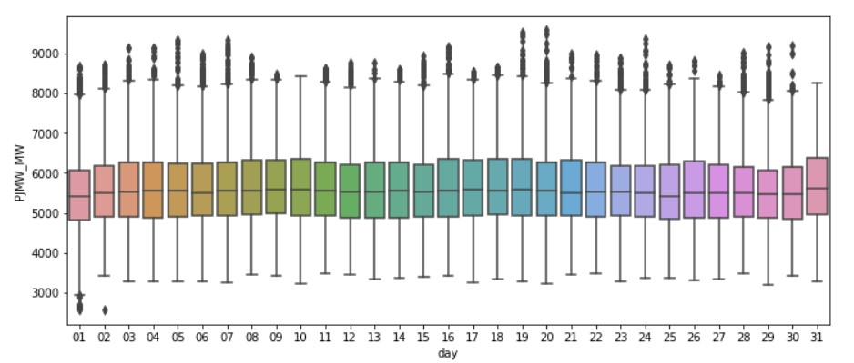
Daily trend
Daily trend Analysis:
Power consumption seems to be constant in daily basis

Slide 11
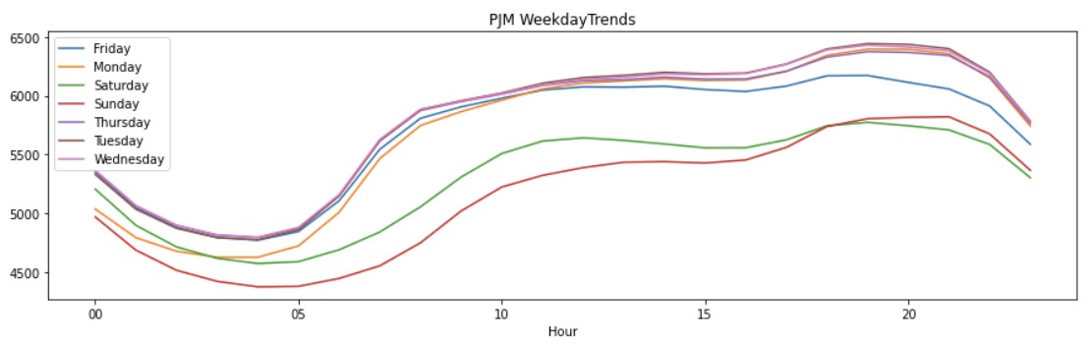
Weekly Trend
Weekly trend Analysis :
The weekends shows less consumption than weekdays.

Slide 12
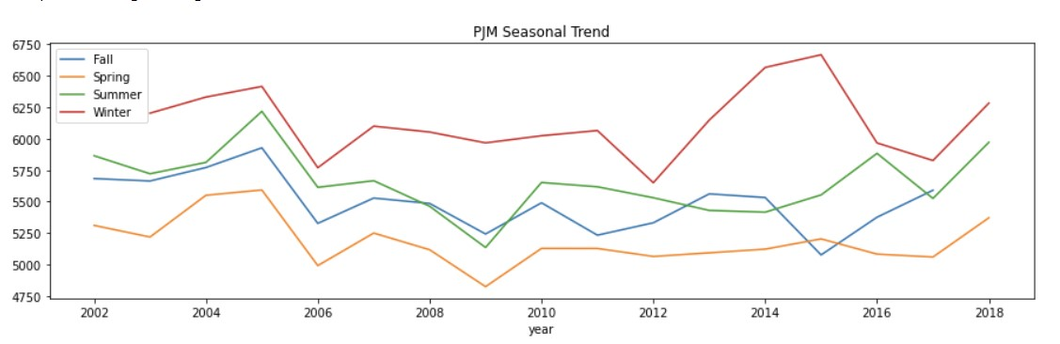
Seasonal Trend
Seasonal trend Analysis :
Winter and summer seasons found to be having higher power consumption than Spring and fall.

Slide 13
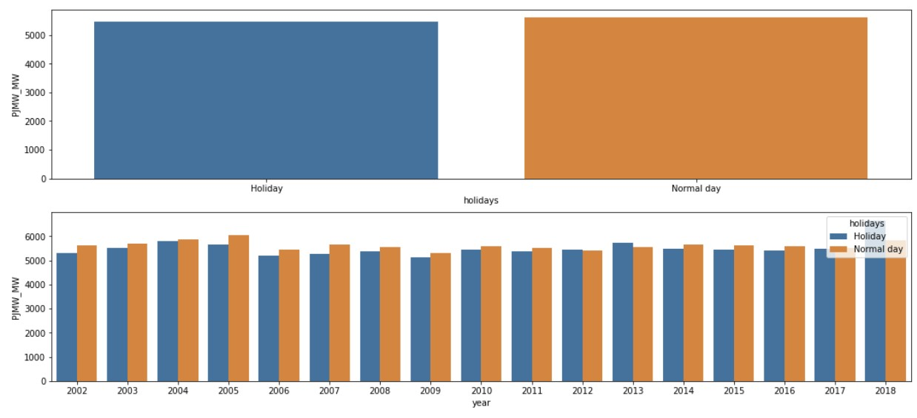
Holiday Trend
Holiday trend Analysis :
There is only negligible difference in power consumption between normal day and holidays.

Slide 14
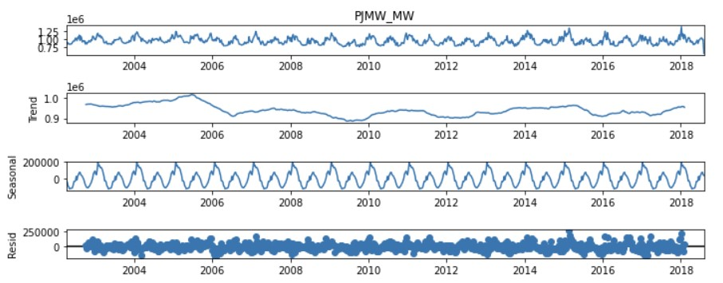
Decomposition
There is no trend since it is neither increasing nor decreasing. Seasonal pattern is consistent. Residuals are whatever is left after fitting the trend and seasonal components to the observed data and are showing some wavy pattern.

Slide 15
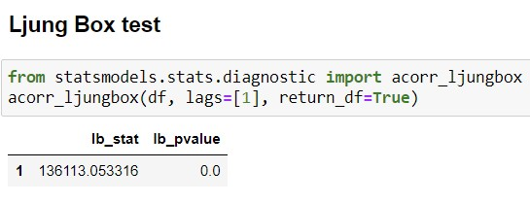
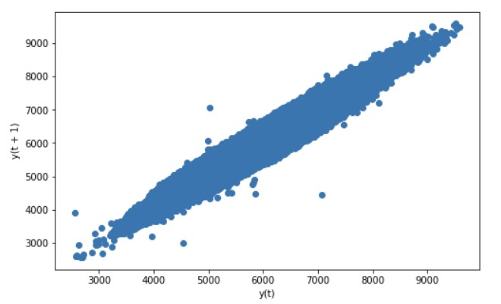
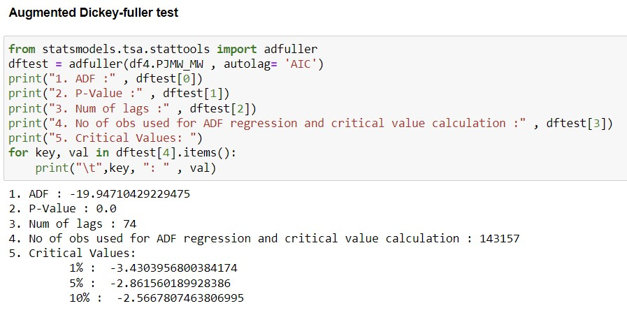
Observations:
Ljung Box test: Since lb_pvalue < 0.05, residuals are uncorrelated.
Lag Plot: Our data has moderate Autocorrelation as the lag plot is in elliptical shape.
Stationarity Checks: Both mean and variance are constant.
Coefficient of Variation: CV < 0.75 Hence its a low variability process
Augmented Dickey-fuller test: Our p-value is definitely less than 0.05 and can assume our data is stationary.
Lag Plot

Slide 16
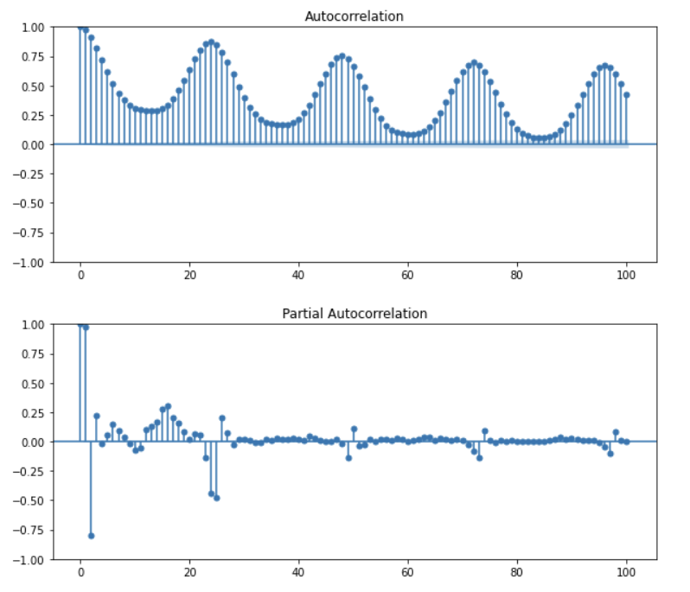
ACF AND PACF Plots:
The ACF shows an oscillation, indicative of a seasonal series.
The values of p(AR), q(MA) and d (I) cannot be deduced from the ACF plot since it exhibits seasonality and the CI bound is not visible.
Similarly, P,D,Q values for seasonal parts of the model are also not visible from PACF plot.
Hence we resampled the data to daily basis and did the differencing to remove the seasonality.

Slide 17
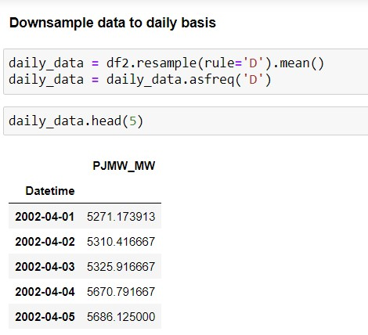
Down sampling of data
We downsize our hourly data into daily using resample rule for better prediction of the model.

Slide 18
Model Building- SARIMA

Slide 19
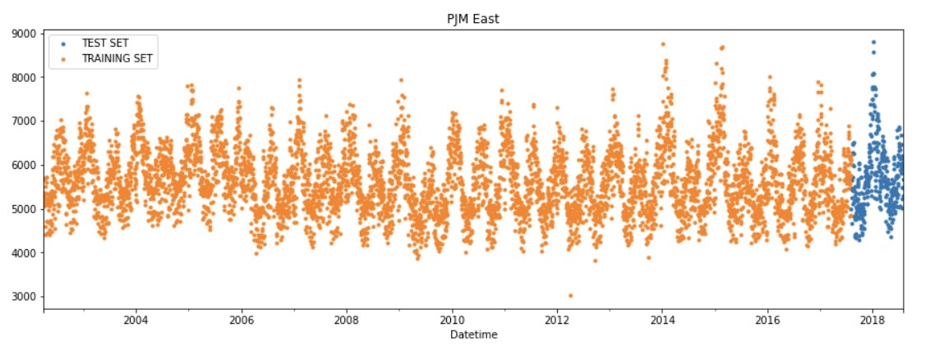
Train – test Split
Split the data into train and test by taking the last 1 year power consumption as test data.

Slide 20
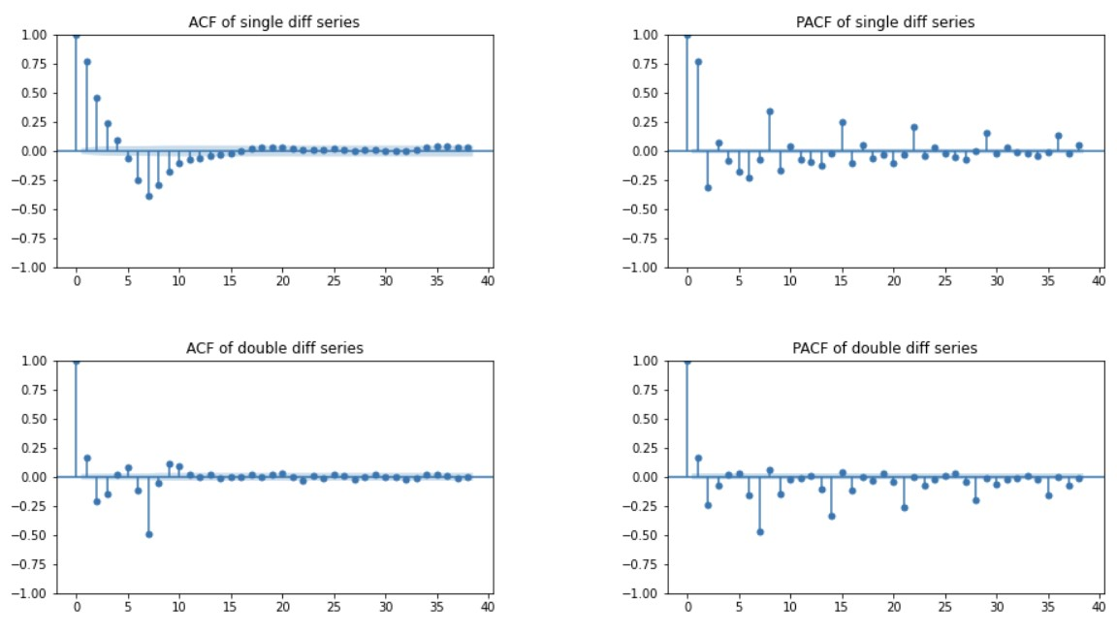
Double differencing – Lag 7
Double differencing with lag 7 to remove the weekly seasonality.

Slide 21
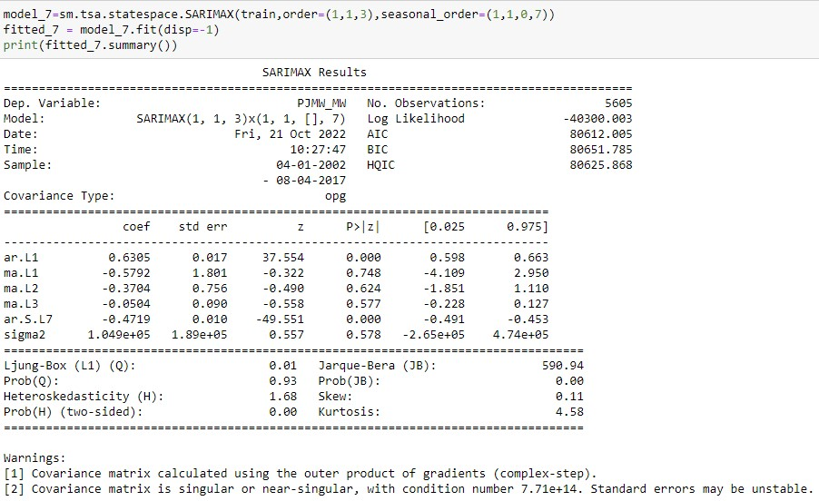
SARIMA Model with weekly seasonality
(p,d,q) = (1,1,3)
(P,D,Q) = (1,1,0)
m = 7

Slide 22
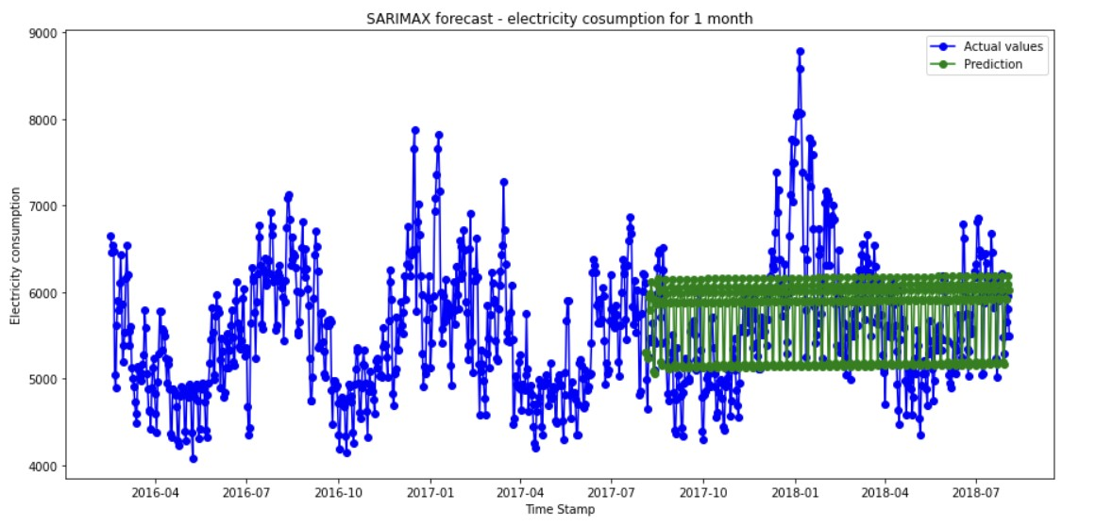
SARIMA Model with weekly seasonality
Model Evaluation
The model captures the weekly seasonality

Slide 23
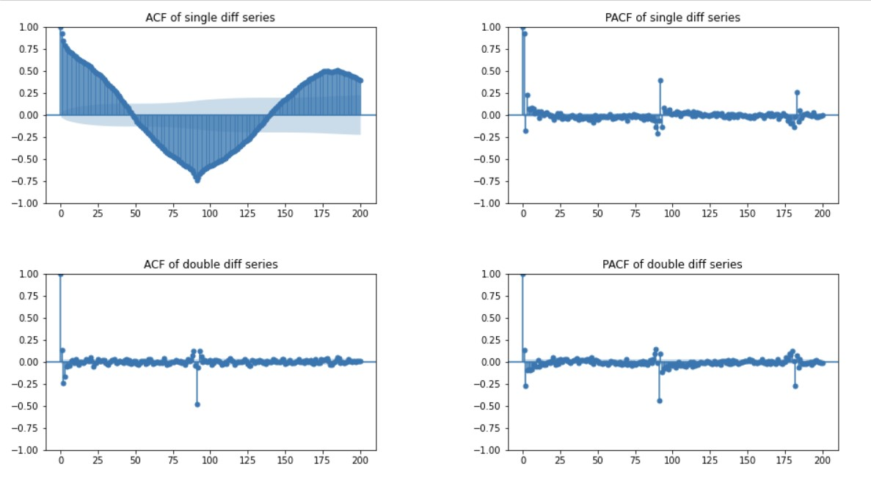
Double differencing – Lag 91
Double differencing with lag 91 to remove the Quarterly seasonality.

Slide 24
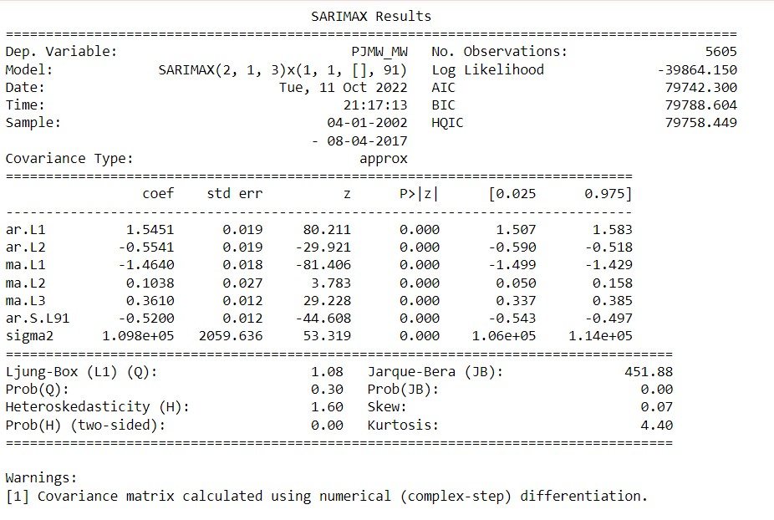
SARIMA Model with Quarterly seasonality
(p,d,q) = (2,1,3)
(P,D,Q) = (1,1,0)
m = 91

Slide 25
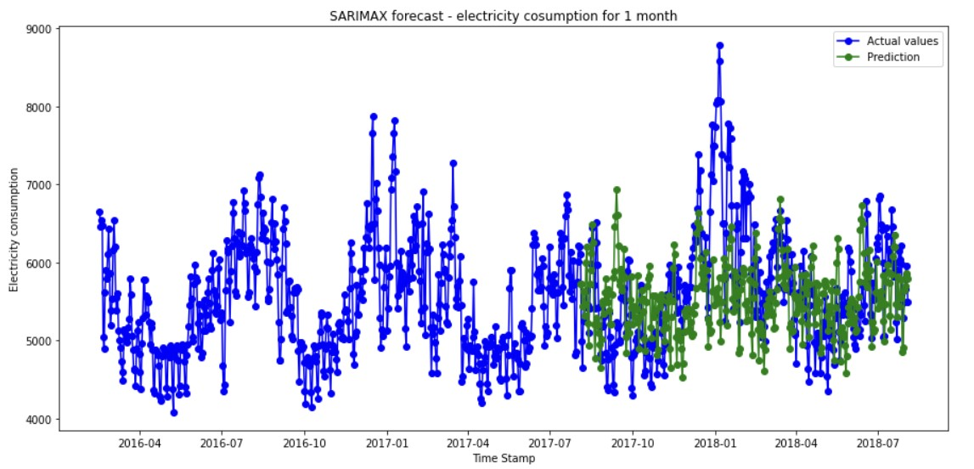
SARIMA Model with Quarterly seasonality
Model Evaluation
The model captures the quarterly seasonality

Slide 26
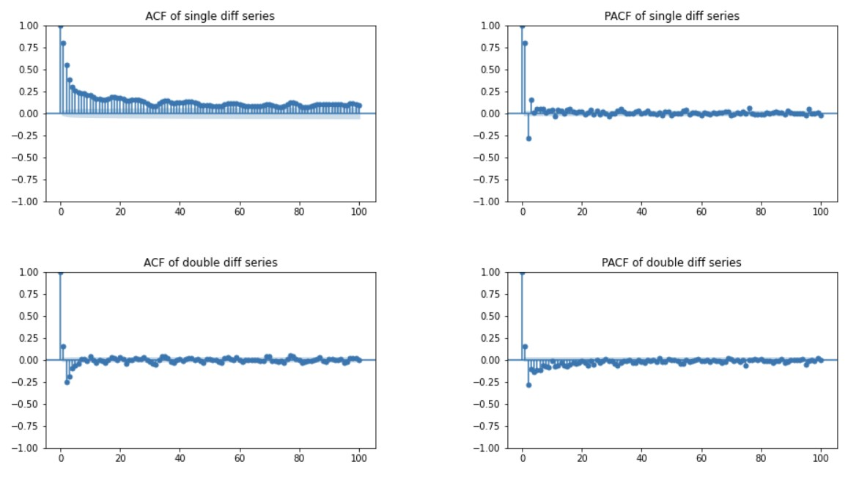
Double differencing – Lag 364
Double differencing with lag 364 to remove the Yearly seasonality.

Slide 27
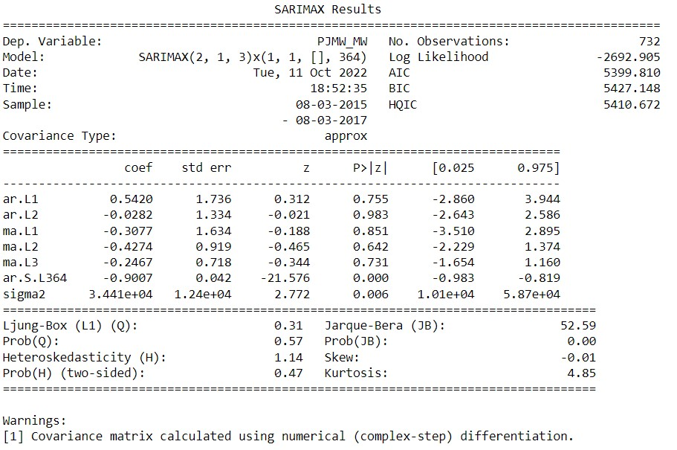
SARIMA Model with Yearly seasonality
(p,d,q) = (2,1,3)
(P,D,Q) = (1,1,0)
m = 364

Slide 28
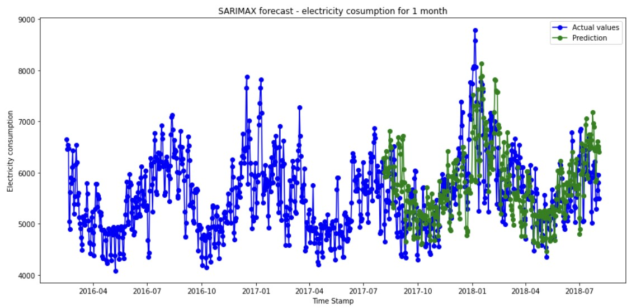
SARIMA Model with Yearly seasonality
Model Evaluation
The model captures the yearly seasonality

Slide 29
OBSERVATIONS
The calculated MAPE, MAE and MSE values of the SARIMA models are given below:
Differencing | SARIMA Models | RMSE | MAE | MAPE
7 - Weekly | S(1,1,3),(1,1,0,7) | 767.35 | 684.29 | 12.06
91 - Quarterly | S(2,1,3)(1,1,0,91) | 785.58 | 686.67 | 11.73
364 - Yearly | S(2,1,3)(1,1,0,364) | 710.86 | 816.81 | 14.37

Slide 30
REGRESSION MODELS
Linear Regression
Random Forest
XG Boost

Slide 31
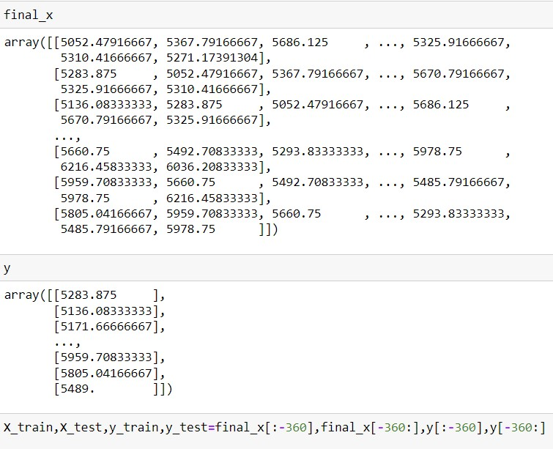
DATA SET
Created x value taking the 7 day shift and y value with the power consumption data.
Split train and test taking last 1 year
Created X_train, X_test, y_train, Y_test
Fitted Linear regression, Random Forest and XG Boost regressor

Slide 32
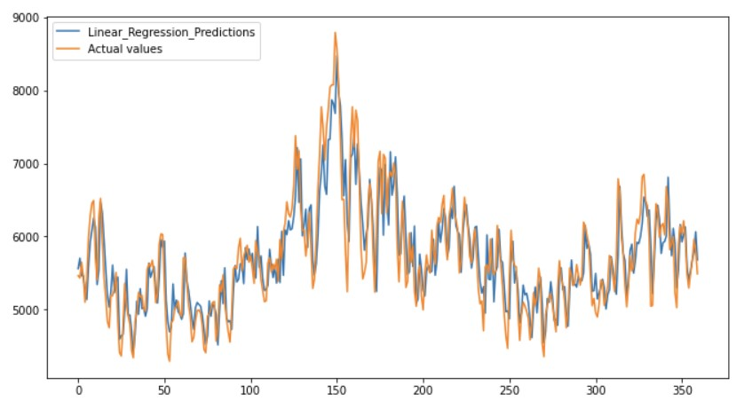
1. LINEAR REGRESSION MODEL
Predicted for the test data with linear regression model.

Slide 33
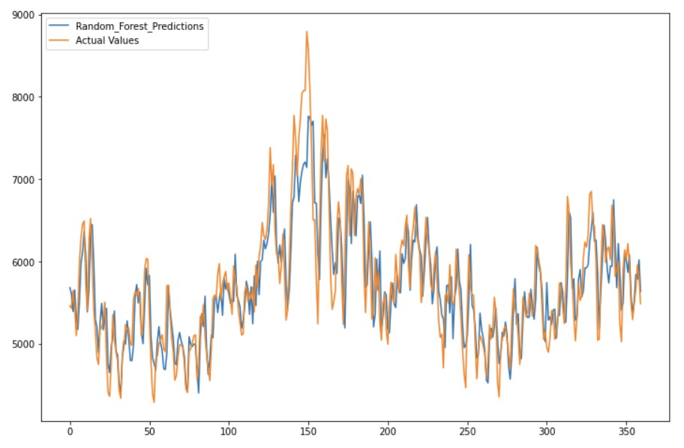
2. RANDOM FOREST MODEL
Predicted for the test data with random forest model

Slide 34
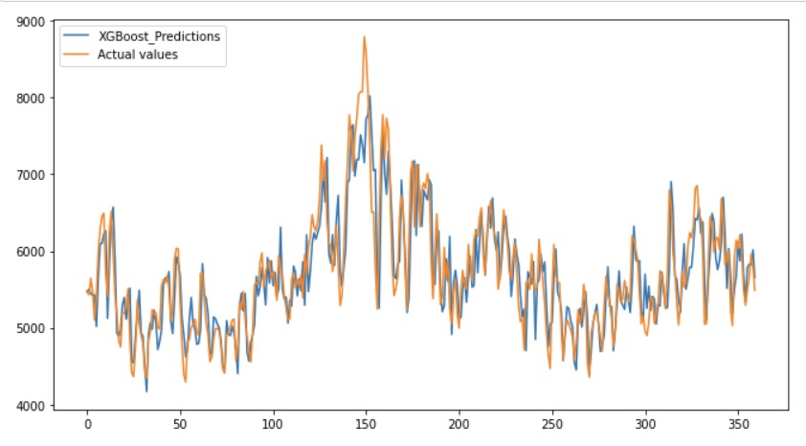
3. XGBOOST MODEL
Predicted for the test data with xg boost regressor

Slide 35
OBSERVATIONS
The calculated MAPE, RMSE and MAE values of regression models are tabled.
Forecasting MAPE, RMSE and MAE values are also calculated and tabled.
Predicted model error values
Model | RMSE | MAE | MAPE
Linear Regression | 354.203 | 274.3 | 4.766
Random Forest | 368.625 | 282.91 | 4.878
XG Boost | 369.54 | 279.77 | 4.787
Forecast model error values
Model | RMSE | MAE | MAPE
Linear Regression | 588.8 | 461.53 | 8.25
Random Forest | 540.81 | 425.21 | 7.57
XG Boost | 575.28 | 448.09 | 7.95

Slide 36
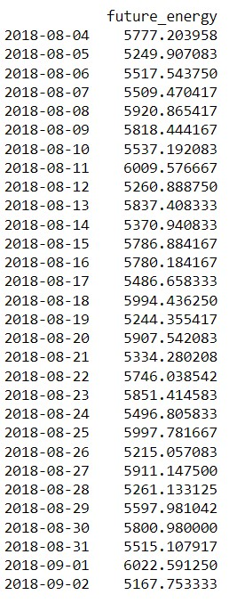
OBSERVATIONS
Forecasting error seems to be less for Random Forest model.
Hence forecasted the next 30 days power consumption from 2018 August 4 to 2018 September 2 using Random Forest model.
The forecasted value is tabled.

Slide 37
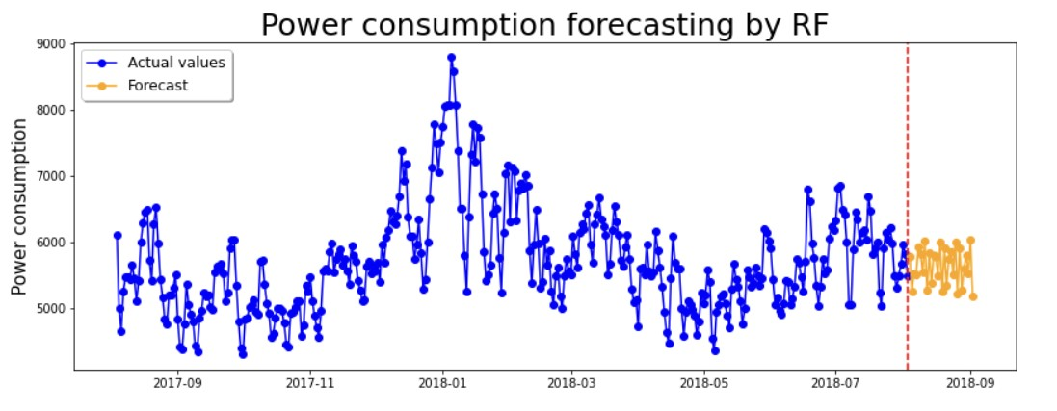
FORECASTED RANDOM FOREST MODEL

Slide 38
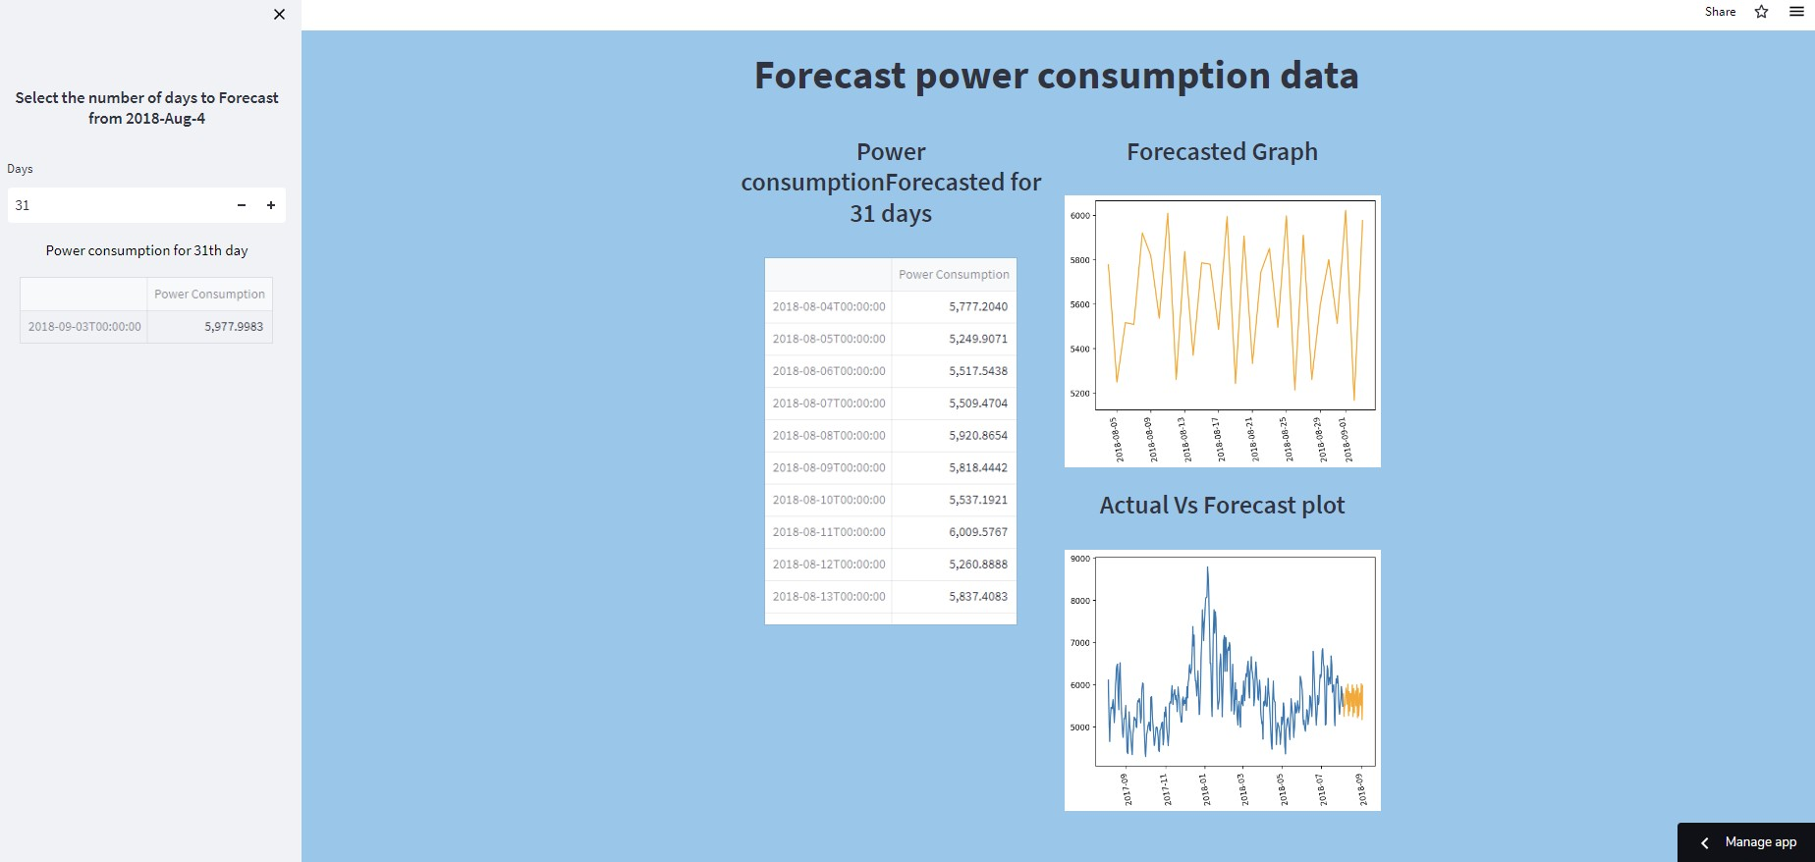
DEPLOYMENT – STREAMLIT APP
The Deployment is done with Streamlit:
The link to the app is: Streamlit (streamlitapp.com)

Slide 39
THANK
YOU!

